Slide 1
Chapter 2 Containerization with Docker

Slide 2
Learning Topics
Overview of Docker
Docker Architecture
Container & Images
Docker Hub
Docker Compose

Slide 3
What is Docker?
Docker is an open platform for developing, shipping and running applications
Docker is a technology to package an application and all its dependencies into a single, easily transportable container
Fixes the traditional “But it works on my machine” problem
Reduce time taken between writing code and running on production

Slide 4
What is Docker? Cont.
Develop Your Applications and Its Supporting Components Using Containers
Container Becomes Unit for Distributing & Testing Your Application
Deploy Your Application, Into Any Environment as a Container

Slide 5
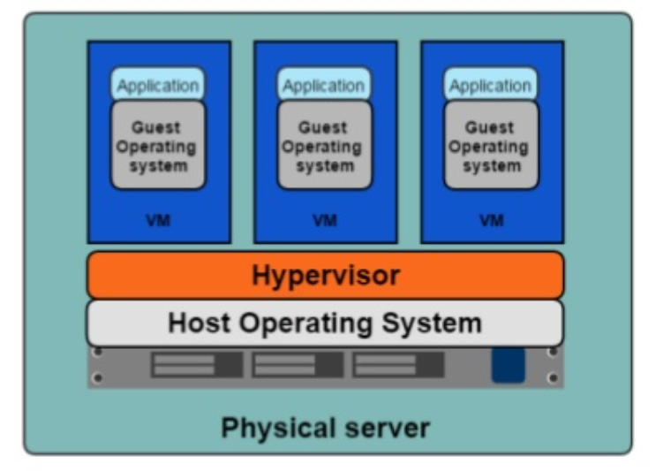
Hypervisor Based Deployments
One physical server can host multiple applications
Each application runs in a virtual machine (VM)

Slide 6
Virtual Machines – Pros & Cons
Each VM Requires its own resources
You need more resources to run more VMs
Application portability is not guaranteed
Easier to Scale
Better Resource Pooling
Supported by Cloud Platforms

Slide 7
Containers
An object for holding or transporting something
Standardized packaging for software and dependencies
Share same OS Kernel
Isolate apps from each other
Lightweight, Isolated and Fast to Boot

Slide 8
Containers Cont.
The basic purpose of Docker is to run containers
A container is a runnable instance of an image
You can create, start, stop, move, or delete a container using the Docker API or CLI
When a container is removed, any changes to its state that are not stored in persistent storage disappear
A container is defined by its image as well as any configuration options you provide to it when you create or start it

Slide 9
Containers Cont.
Container can expose ports and volumes to interact with other containers or/and outer world
Containers are always created from images
Containers gives you instant application portability
All containers must use the same operating system
A container is defined by its image as well as any configuration options provided to it when it is created or started

Slide 10
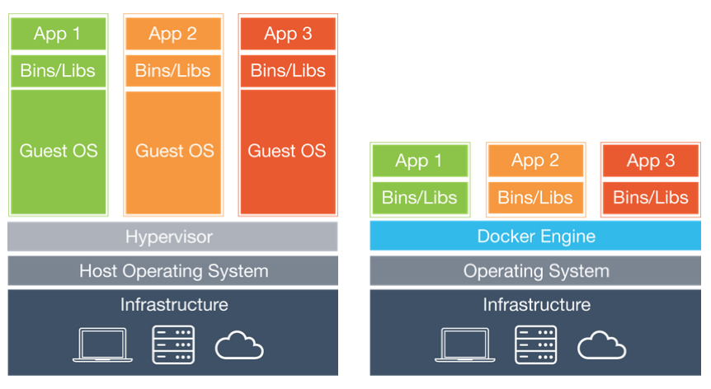
VMs Vs Containers
Infrastructure level construct
App level construct

Slide 11
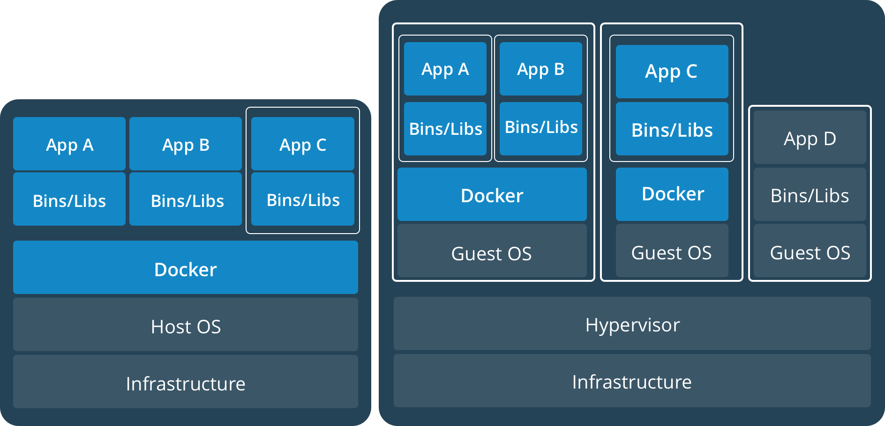
Containers AND VMs
Containers can run on standalone physical server and virtual machines
Provides tremendous flexibility for organizations
Deploy and manage apps

Slide 12
Docker – Lab 1
Run “Hello World” Docker Container

Slide 13
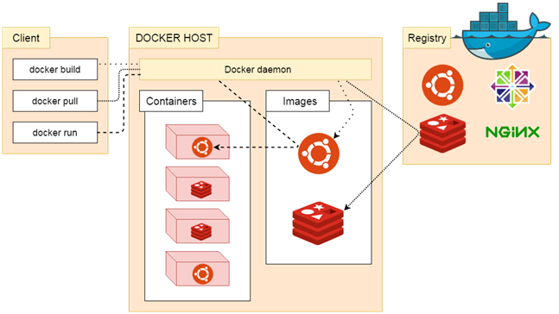
Docker Architecture
Docker uses a client-server architecture.
The Docker client talks to the Docker daemon, which does the heavy lifting of building, running, and distributing your Docker containers.
The Docker client and daemon can run on the same system, or you can connect a Docker client to a remote Docker daemon.
The Docker client and daemon communicate using a REST API, over UNIX sockets or a network interface.

Slide 14
Docker Daemon
The Docker daemon listens for Docker API requests
It manages Docker objects such as images, containers, networks, and volumes
A daemon can also communicate with other daemons to manage Docker services.

Slide 15
Docker Client
The Docker client is the primary way that many Docker users interact with Docker
When we use commands such as docker run, the client sends these commands to docker daemon, which carries them out
The docker command uses the Docker API
The Docker client can communicate with more than one daemon

Slide 16
Docker Registries
A Docker registry stores Docker images.
Docker Hub and Docker Cloud are public registries that anyone can use
Docker is configured to look for images on Docker Hub by default
You can configure your own private registry
When you use the docker pull or docker run commands, the required images are pulled from your configured registry
When you use the docker push command, your image is pushed to your configured registry

Slide 17
Images
In Docker, everything is based on Images
An image is a read-only template with instructions for creating a Docker container
Usually an image is based on another image, with some additional customization.
For example, you may build an image which is based on the ubuntu image, but installs the Apache web server and your application, as well as the configuration details needed to make your application run.

Slide 18
Docker Platform Components
A complete platform
Manage entire lifecycle
Base engine for containers
Registry for image management
Compose for orchestration
Swarm for clustering
Machine for provisioning
Volumes for Storage

Slide 19
Use Cases of Docker
Distributed Applications
Microservices
Continuous Integration
Continuous Deployment
Setting up Development Environment
Build, Ship and Run Any App, Anywhere

Slide 20
Lab 2 – Run Container From Image

Slide 21
Lab 3 – Portainer
Lightweight management UI
Manage various Docker environments
Consists of a single container
Allows you to manage
Docker containers
Images
Volumes
Networks
Much More

Slide 22
Dockerfile
A Blueprint to Build Docker Images
A text document that contains all the commands, in order, a user could call on the command line to assemble an image
Build instructions to build the image
1M+ Dockerfile on GitHub
Located in root of context
docker build -f /path/to/a/Dockerfile .

Slide 23
Dockerfile Instructions
A Dockerfile must start with a `FROM` instruction
The FROM instruction specifies the base image from which you are building
Docker treats lines that begin with # as a comment

Slide 24
Lab 4 – Dockerfile

Slide 25
Docker Hub
Docker Hub is a cloud-based registry service
Docker users and partners create, test, store and distribute container images
Centralized resource for container image discovery, distribution and change management
User and team collaboration and workflow automation throughout the development pipeline.

Slide 26
Docker Hub - Features
Image Repositories - Lets you share images with co-workers, customers, or the Docker community at large
Organizations - Create work groups to manage access to image repositories
GitHub and Bitbucket Integration - Add the Hub and your Docker Images to your current workflows

Slide 27
Lab 5 – Save Image in Docker Hub

Slide 28
Docker Compose
Tool for defining and running multi-container Docker applications
Uses YAML file for configuration
3 Step Process
Create Dockerfile with Environment Information
Define Services for Your App in YAML file
Run Docker Compose

Slide 29
Lab 6 - Docker Compose
Create a Stack Using Docker Compose

Slide 30
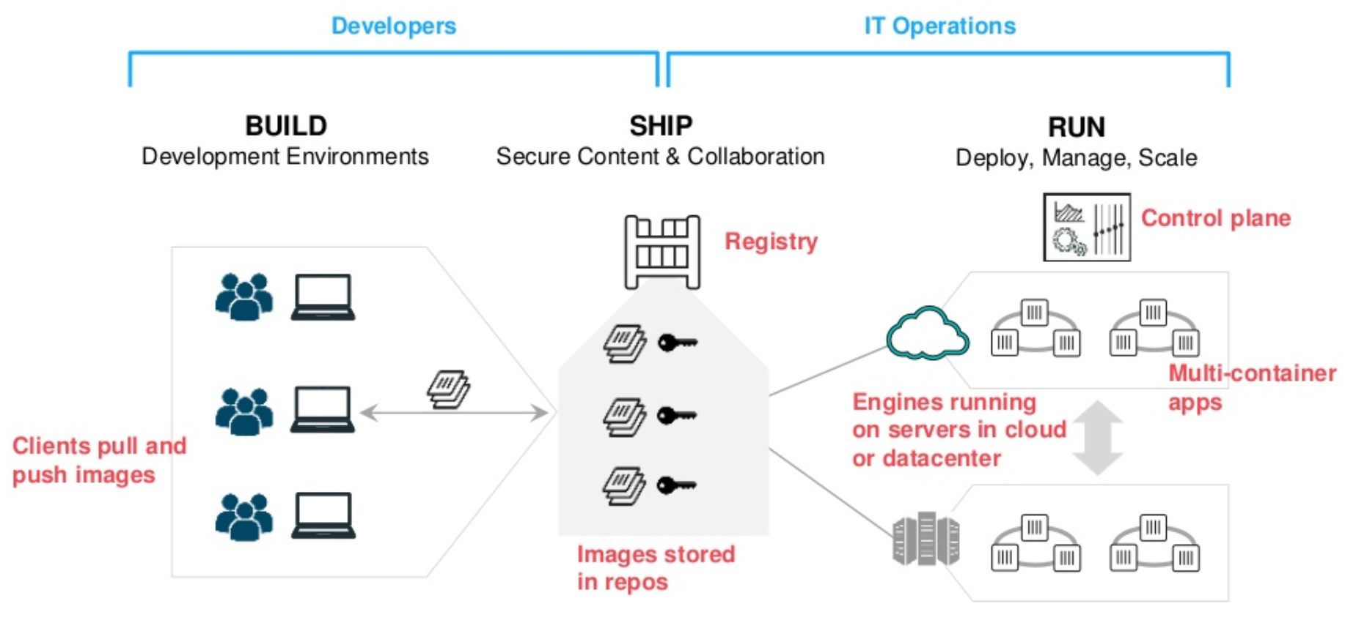
Containers as a Service

Slide 31
Docker Key Takeaways
Build Image Using Dockerfile
Store Image Using Docker Hub
Use Portainer as a Visualizer
Manage Application Data Using Volumes
Define App Stack Using Docker Compose

Slide 32
This concludes Chapter 2 – Containerization with Docker Let us move to Chapter 3 – Container Orchestration with Kubernetes

